Slide 1
JJMR COSMETICS
DEVELOPERS:
OBERES, JAY
CABALLES, JEZZEL
JACABAN, MERRYBETH
CALOOMARDE, RONIL
“BEAUTY IS NOT THE FLAWLESS,IT SHINES EVEN THROUGH YOUR FLAWS”.

Slide 2
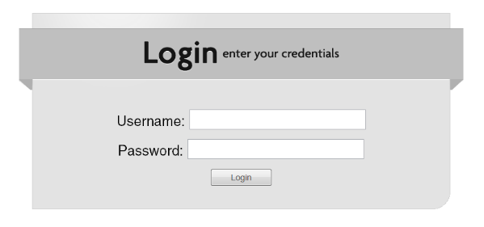
LOGIN SYSTEMS

Slide 3
REQUIRE FUNCTION:
Accepts user information
Accepts user data
Store any kind of information
Display the products

Slide 4
FEATURES:
Easy to log-In
Accessible

Slide 5
Purpose of Applet
To let people know how to use beauty product in the right way.
To enhance the confidence of every woman and also to the LGBTQ community
Gives information about beauty products

Slide 6
PROTOTYPE OF APPLET
STEPS AND GUIDANCE

Slide 7
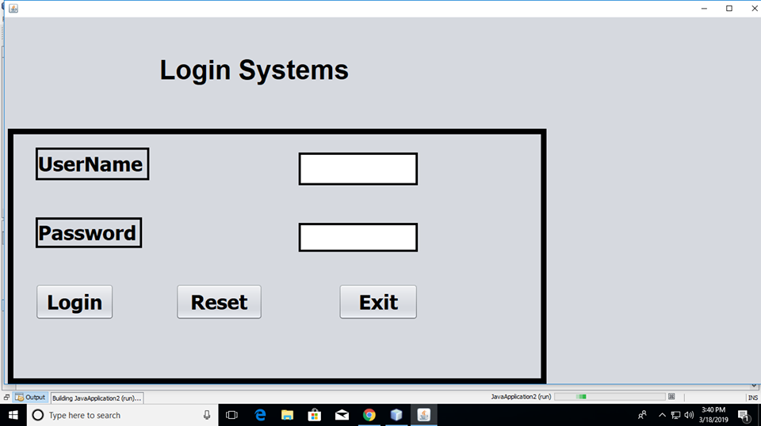
STEP 1: Note: You need to log in to have your own credential profile.

Slide 8
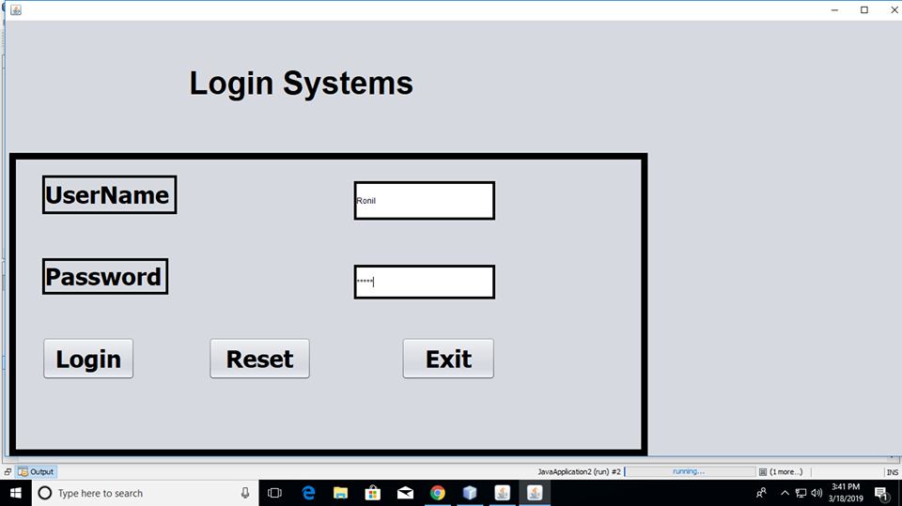
STEP 2: Note: Enter your username and password.

Slide 9
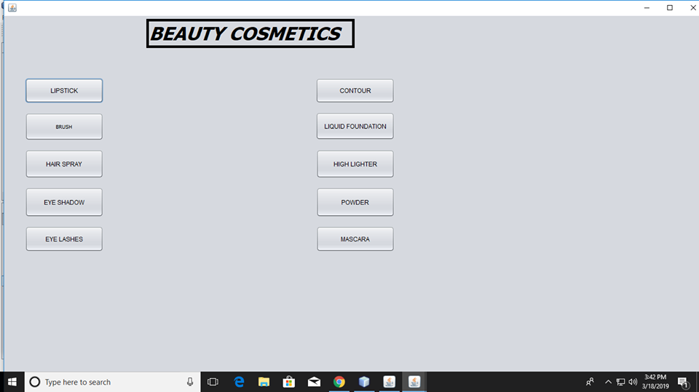
STEP 3: Note: You can now see the different type of JJMR COSMETICS that you need to know about.

Slide 10
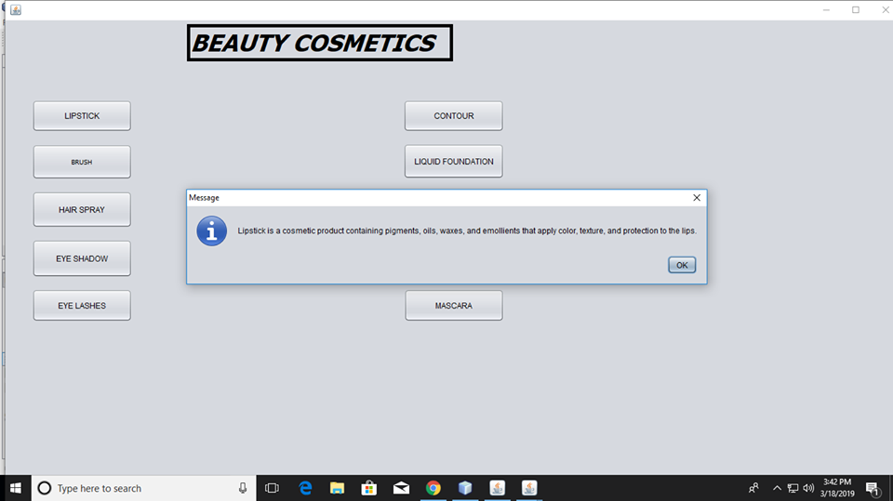
STEP 4: Note: You will already know how to use and apply the JJMR COSMETICS that you want.

Slide 11


